Slide 1
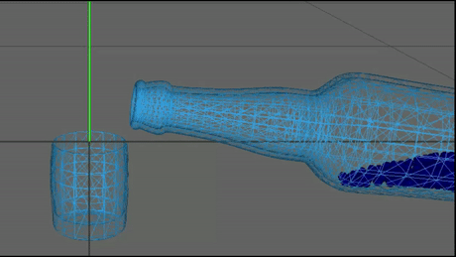
On solving the water pouring problem with simulation and reinforcement learning
Bachelor thesis by Yannik Keller

Slide 2
Thesis goals
Create a reusable water-pouring reinforcement learning environment
Solve the environment using a state-of-the-art reinforcement learning algorithm
Explore how changes in the environment impact the performance of a RL agent.
Test approaches to make the problem in the environment more similar to the problem humans face when pouring in water.

Slide 3
(Water-)Pouring
Difficulties:
Precise motion is required.
Physical behaviour of fluid is hard to predict.
Uncertainty about the state of the system.
One of the most regularly executed motor control task in everyday life.
Easy for humans.
Difficult problem in robotics for many years.
Notes:
Fluid behaviour is governed by Navier–Stokes equations, which are partial differential equations that are hard to solve.

Slide 4

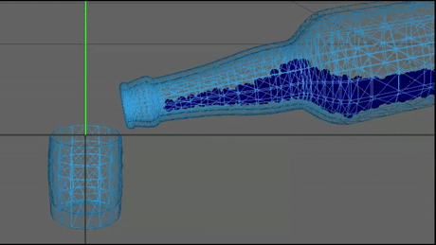
Why Reinforcement Learning?
Neuroscience shows that concepts of RL play an important role in human motor control. (FitzGerald et al., 2012)
Learning can be done by trial and error in a simulator.
Rotate Bottle,
Move Bottle
(1)
Notes:
FitzGerald has shown evidence for action-values in the brain via fMRI

Slide 5
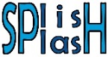
The water-pouring reinforcement learning environment
Model a pouring scene using 3d models of a bottle and a glass
Simulate the behaviour of the water using , an open source fluid simulator.
Water is approximated by particles that capture the properties of the fluid in a small region.
The agent controls the bottle and has the goal to pour in water into the glass.

Slide 6
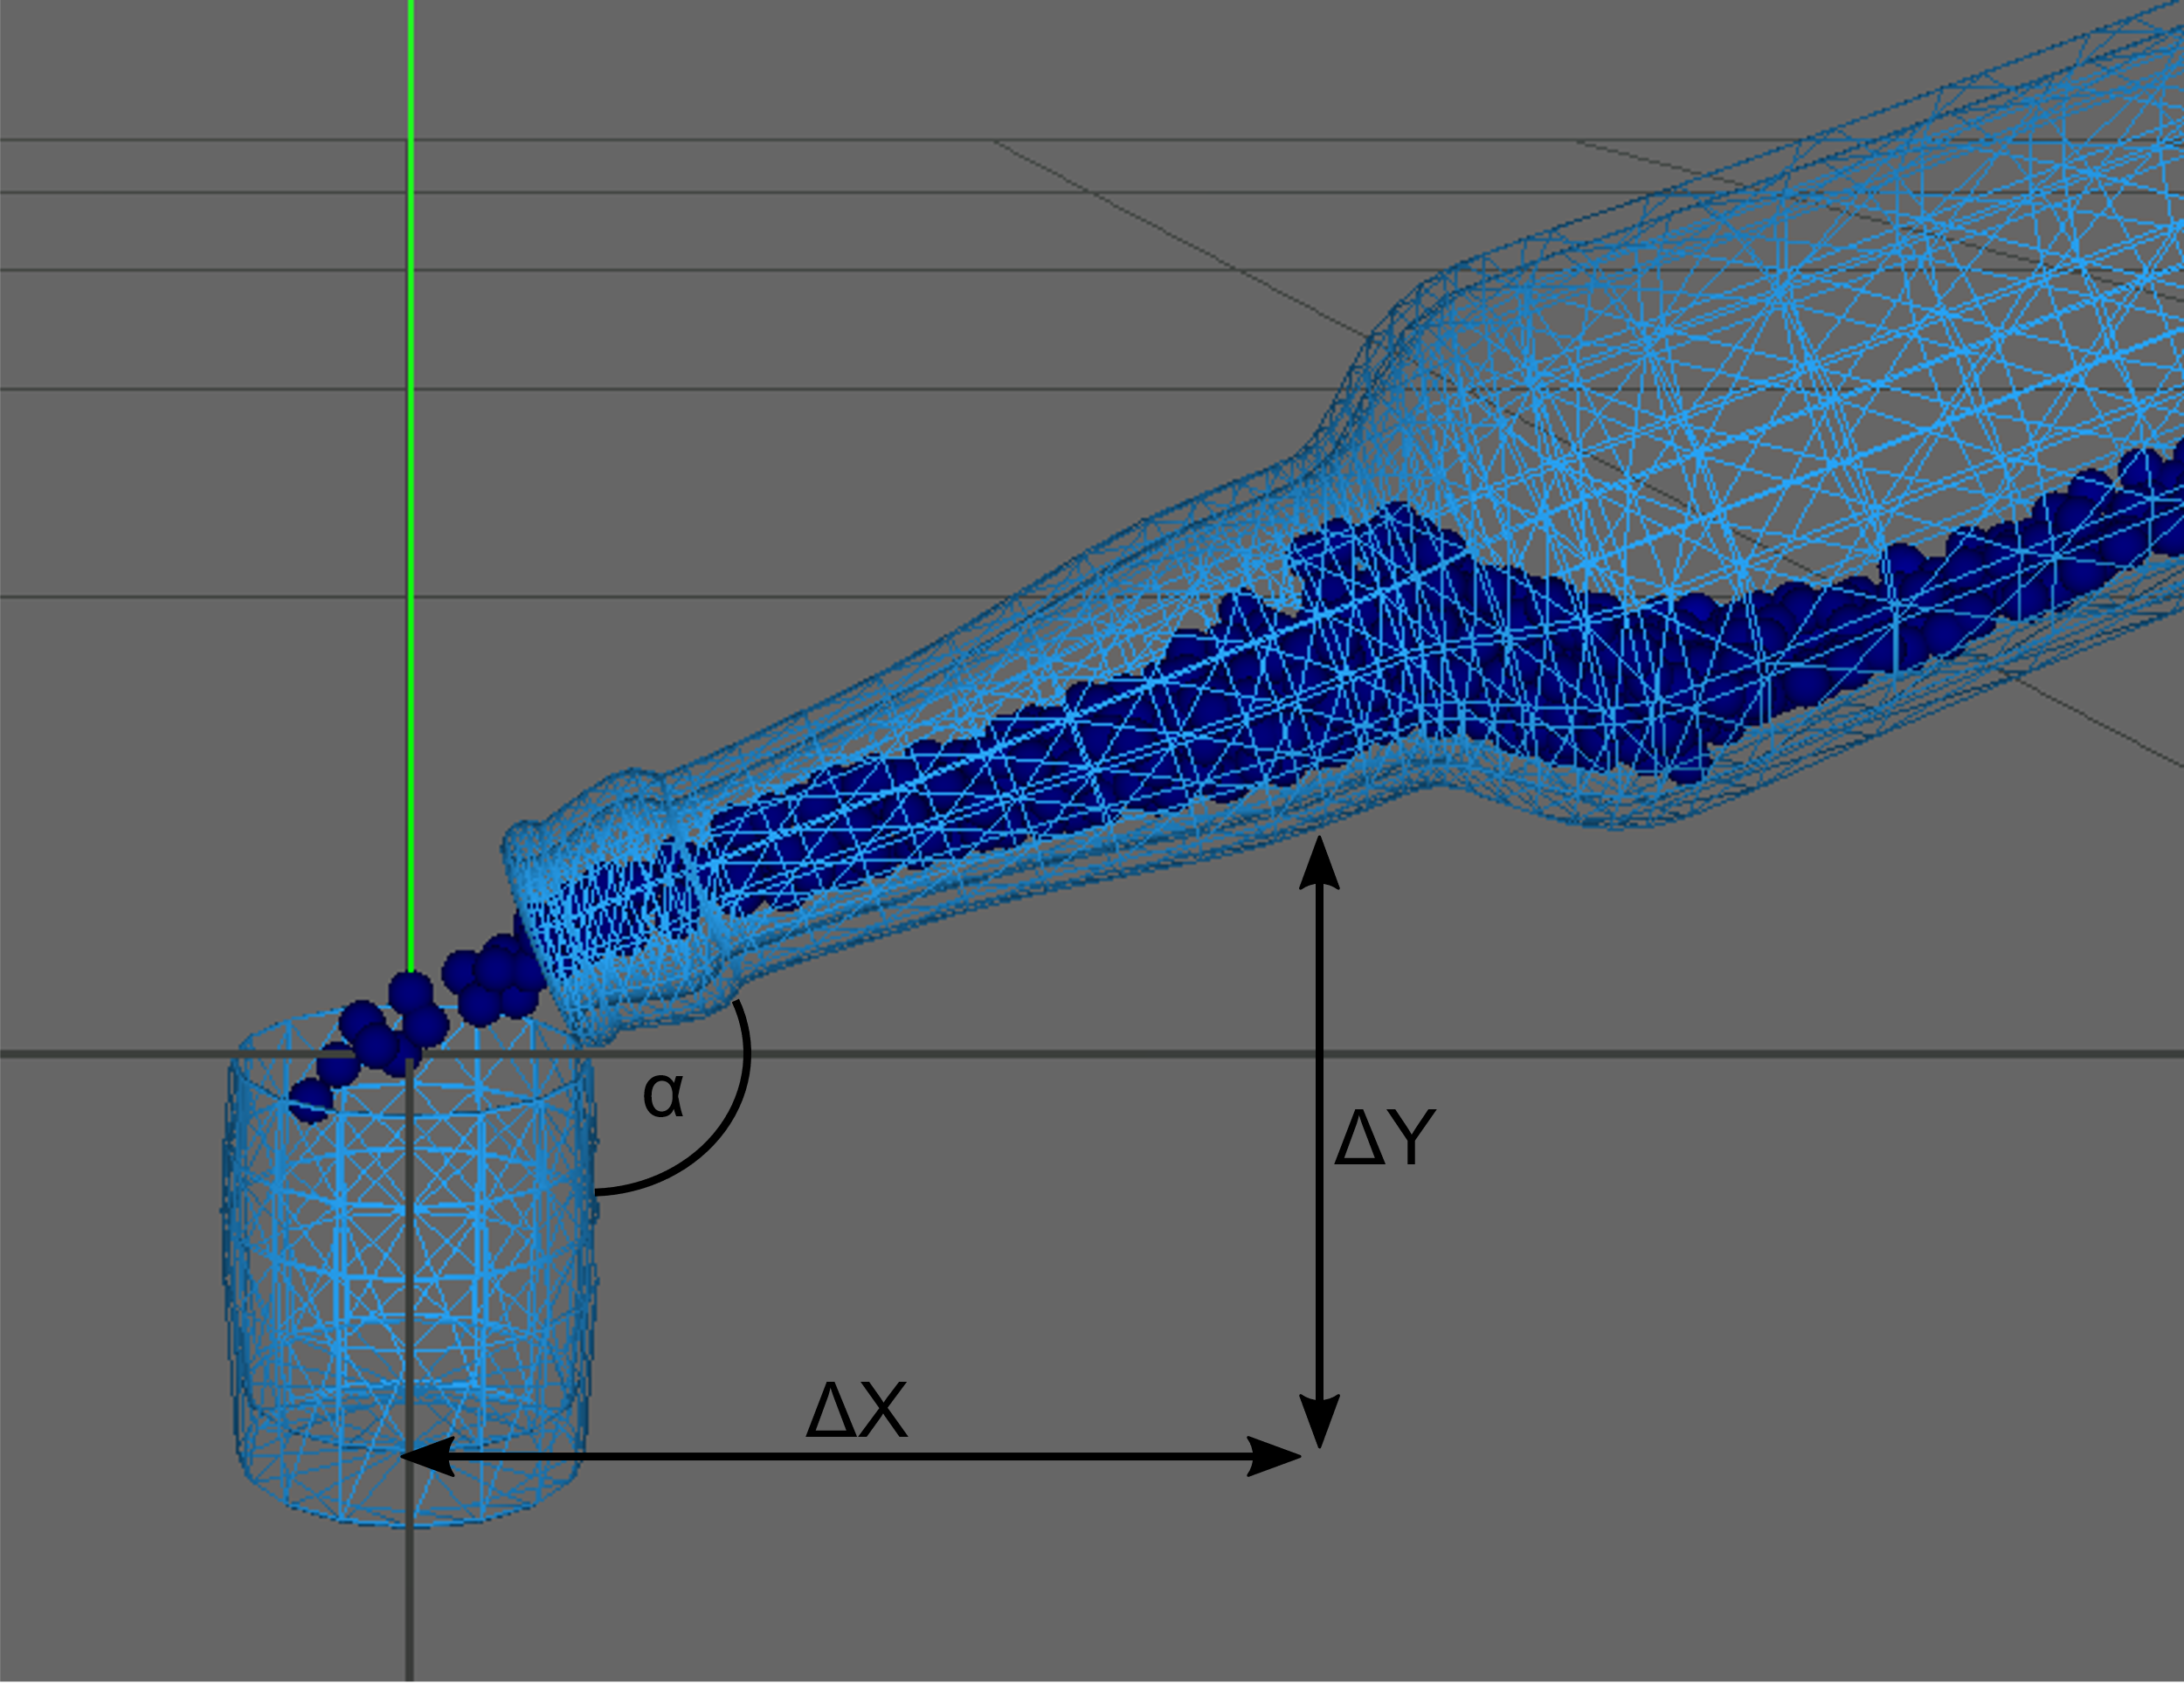
Degrees of freedom of the agent (actions)

Slide 7
MDP or POMDP?
Humans do not fully observe the state of the system when pouring in water => POMDP
Most reinforcement learning algorithms are formulated in the domain of MPDs
Create MDP and POMDP version and compare the ability of reinforcement learning algorithms to solve each of them.

Slide 8
POMDP vs MDP. Agent Observations
MDP:
3D Position and Velocity of all Water Particles
Bottle Rotation and Position
Goal fill-level
POMDP:
Fill-level of bottle and glass
Amount of spilled water
Amount of water between bottle and glass (in the air)
Bottle Rotation and Position
Goal fill-level

Slide 9
Twin Delayed Deep Deterministic Policy Gradient (TD3)
Model-Free reinforcement learning algorithm
Off-Policy
Continuous action and state space
Actor-Critic architecture with one deep neural network for the actor and two for the critic.
Proposed by Fujimoto et al. (2018), still considered SOTA
Formulated in domain of MDPs, but known to work for POMDPs if observations are discriminative enough.

Slide 10
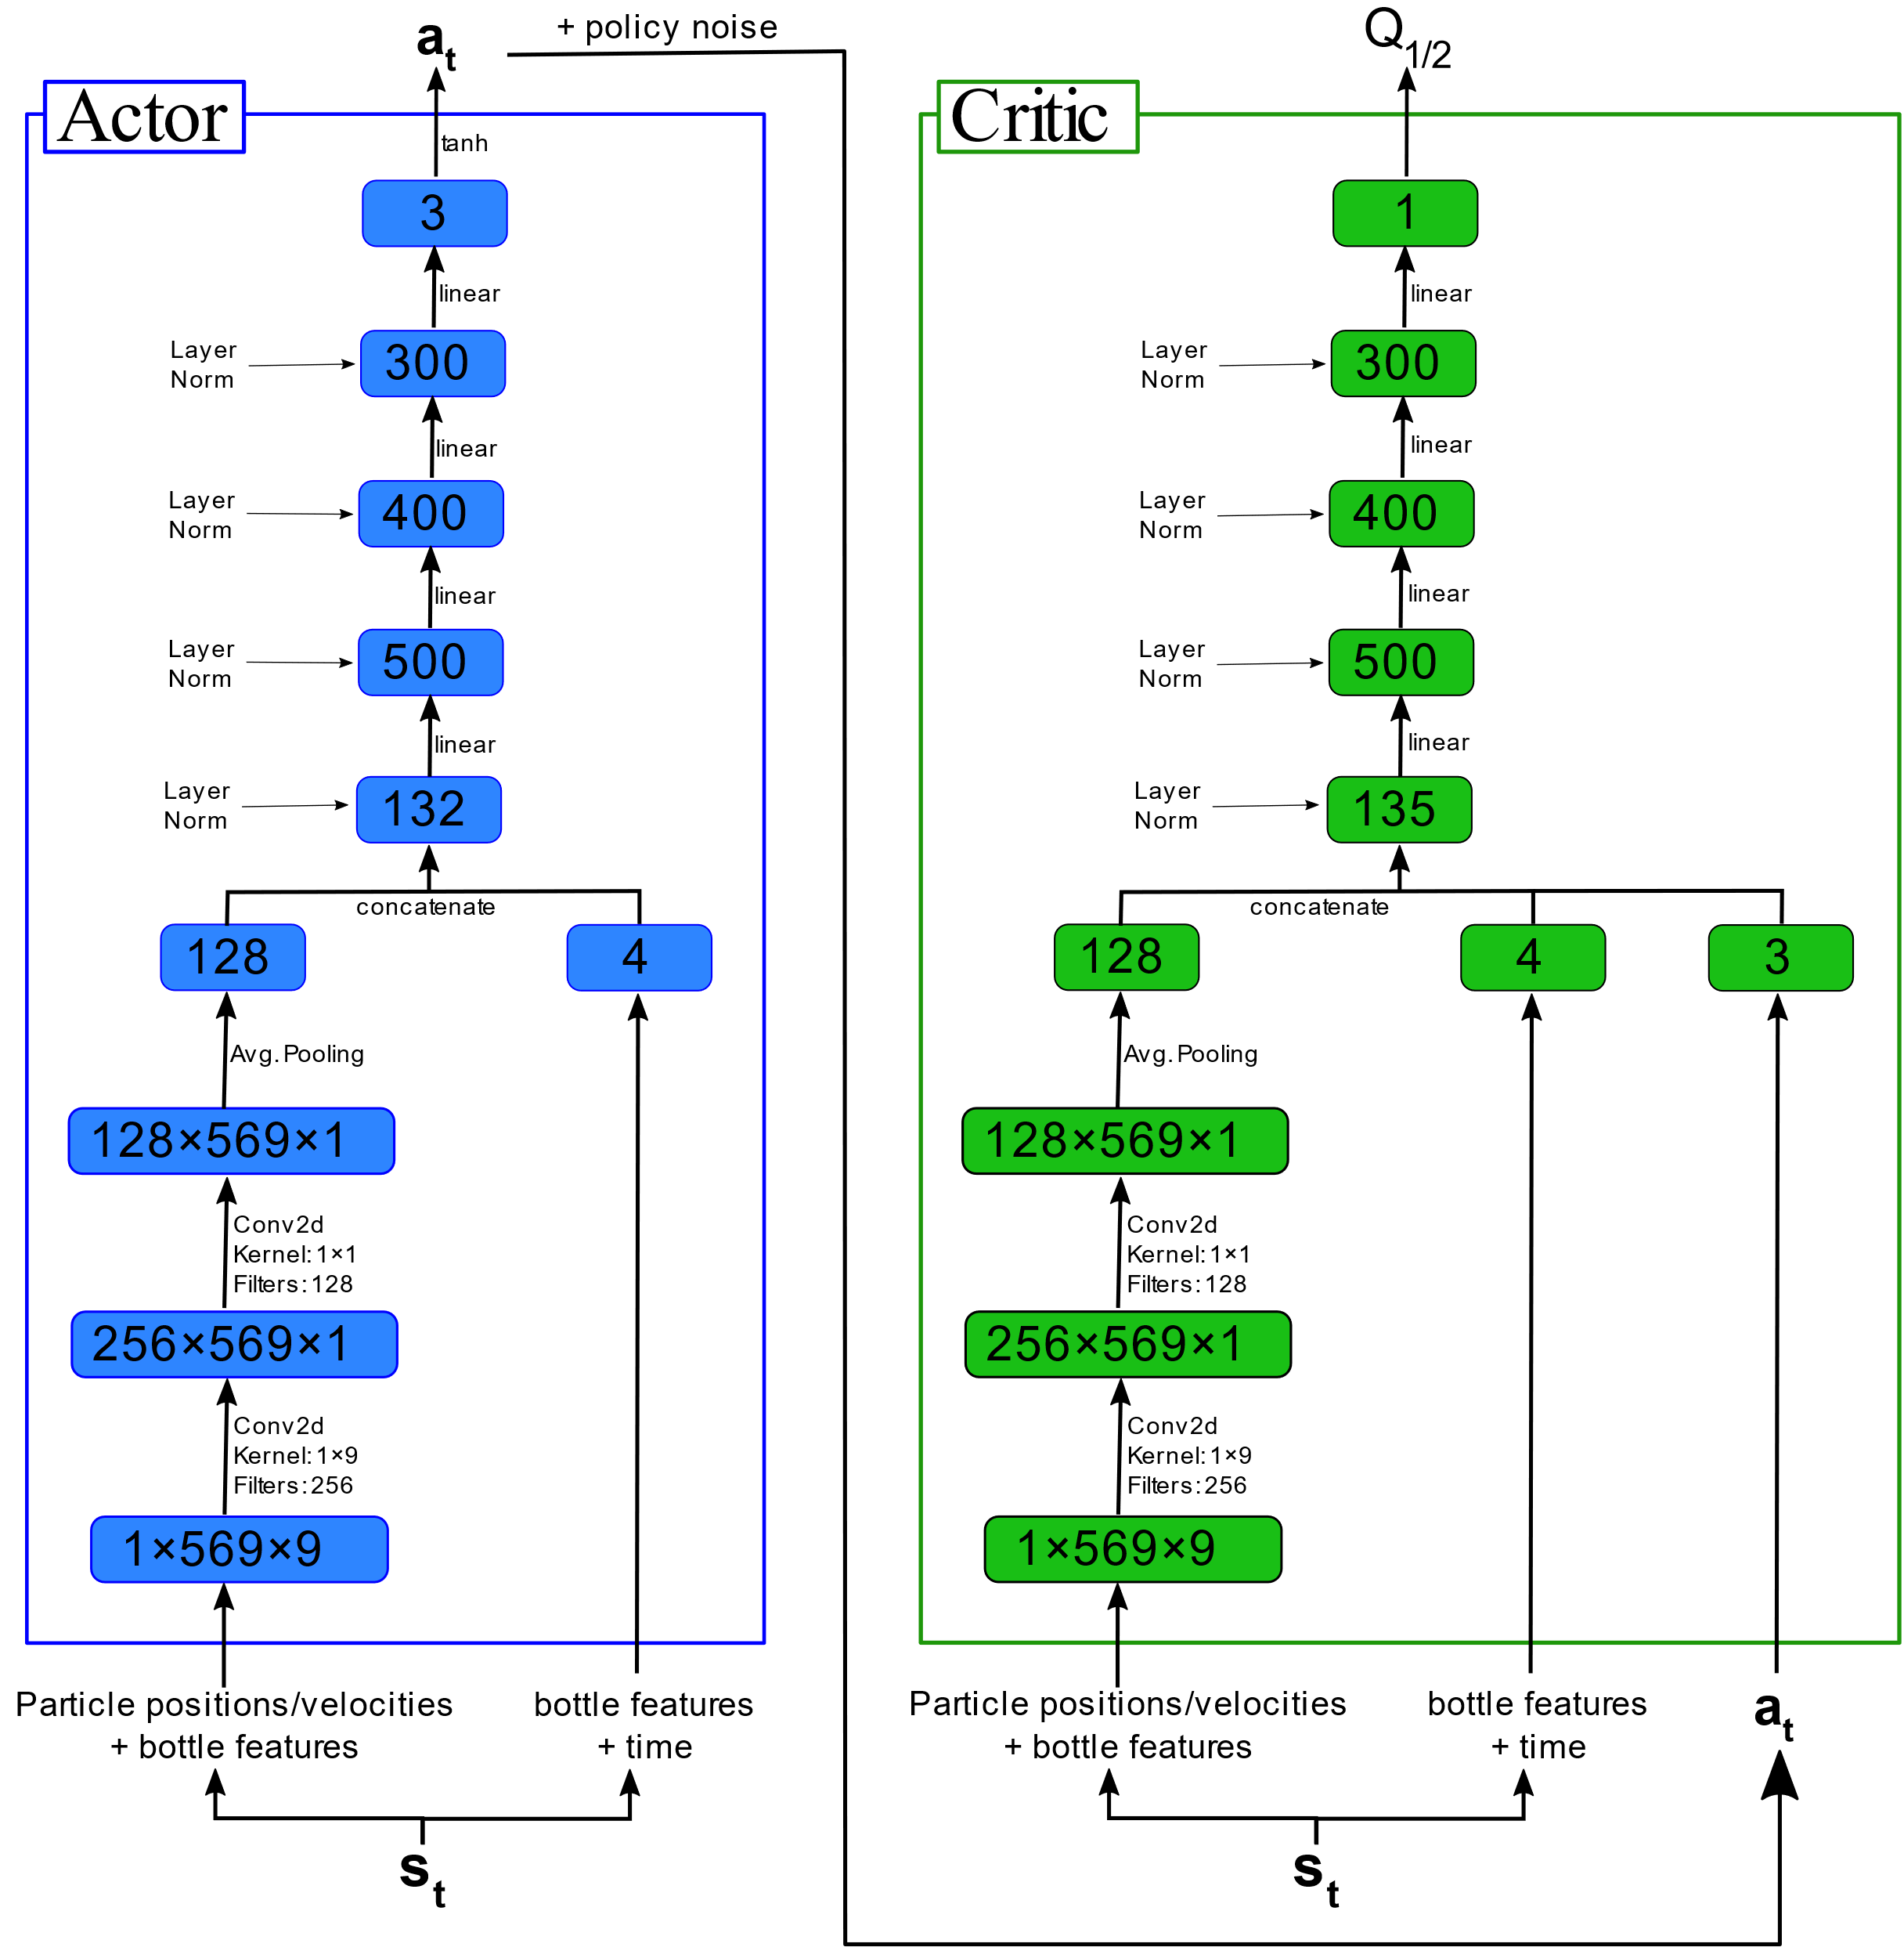
Actor-Critic architecture to tackle MDP version

Slide 11
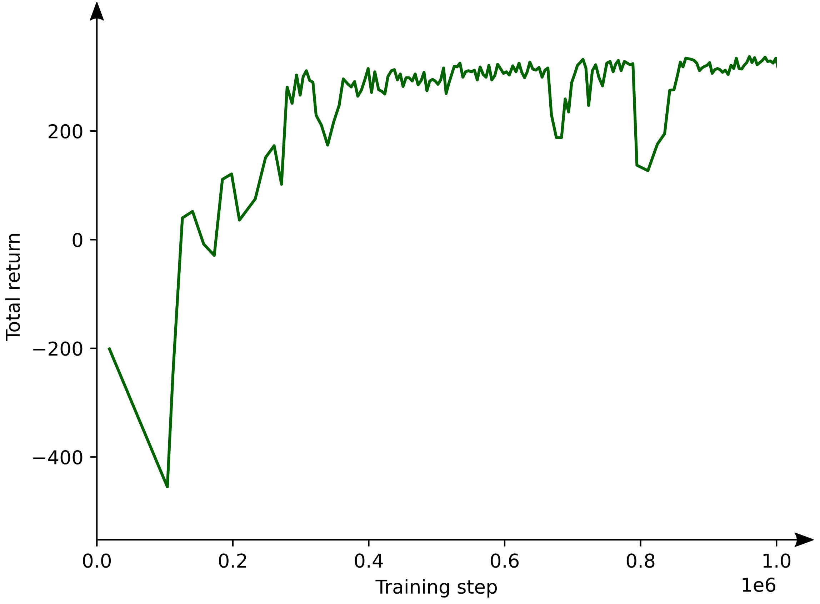
Neural Network Training
Training was performed on a single GPU on a DGX-2 machine.
In each experiment, the network was trained for 1,000,000 steps.

Slide 12
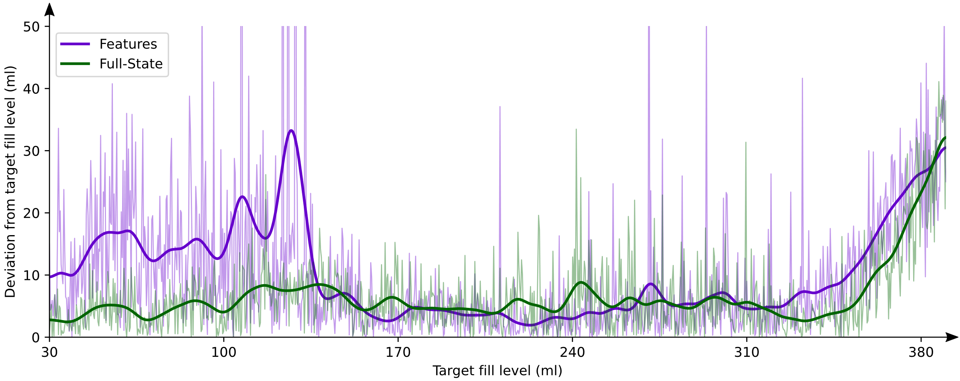
MDP vs POMDP deviation from target-fill level
POMDP
MDP
Notes:
POMDP has few information about the state of the system before the first water leaves the bottle => pouring in low amounts of water is difficult.

Slide 13
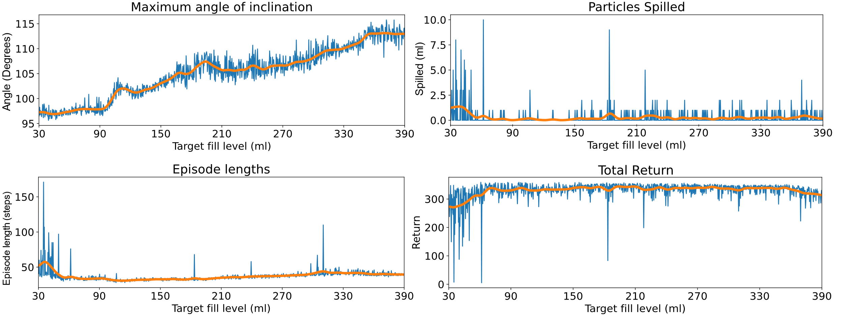
Agent behaviour depending on target fill-level

Slide 14
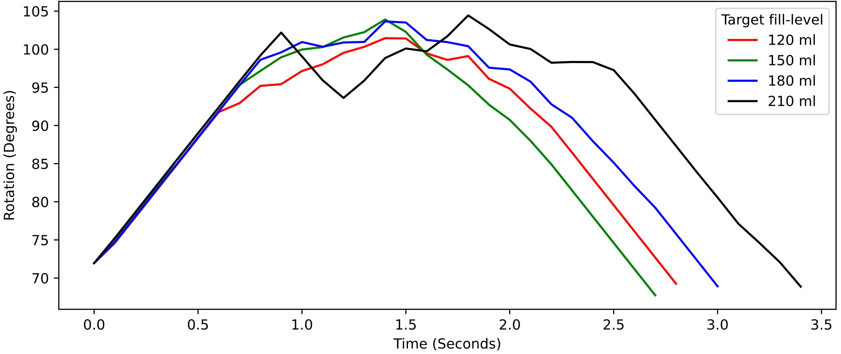
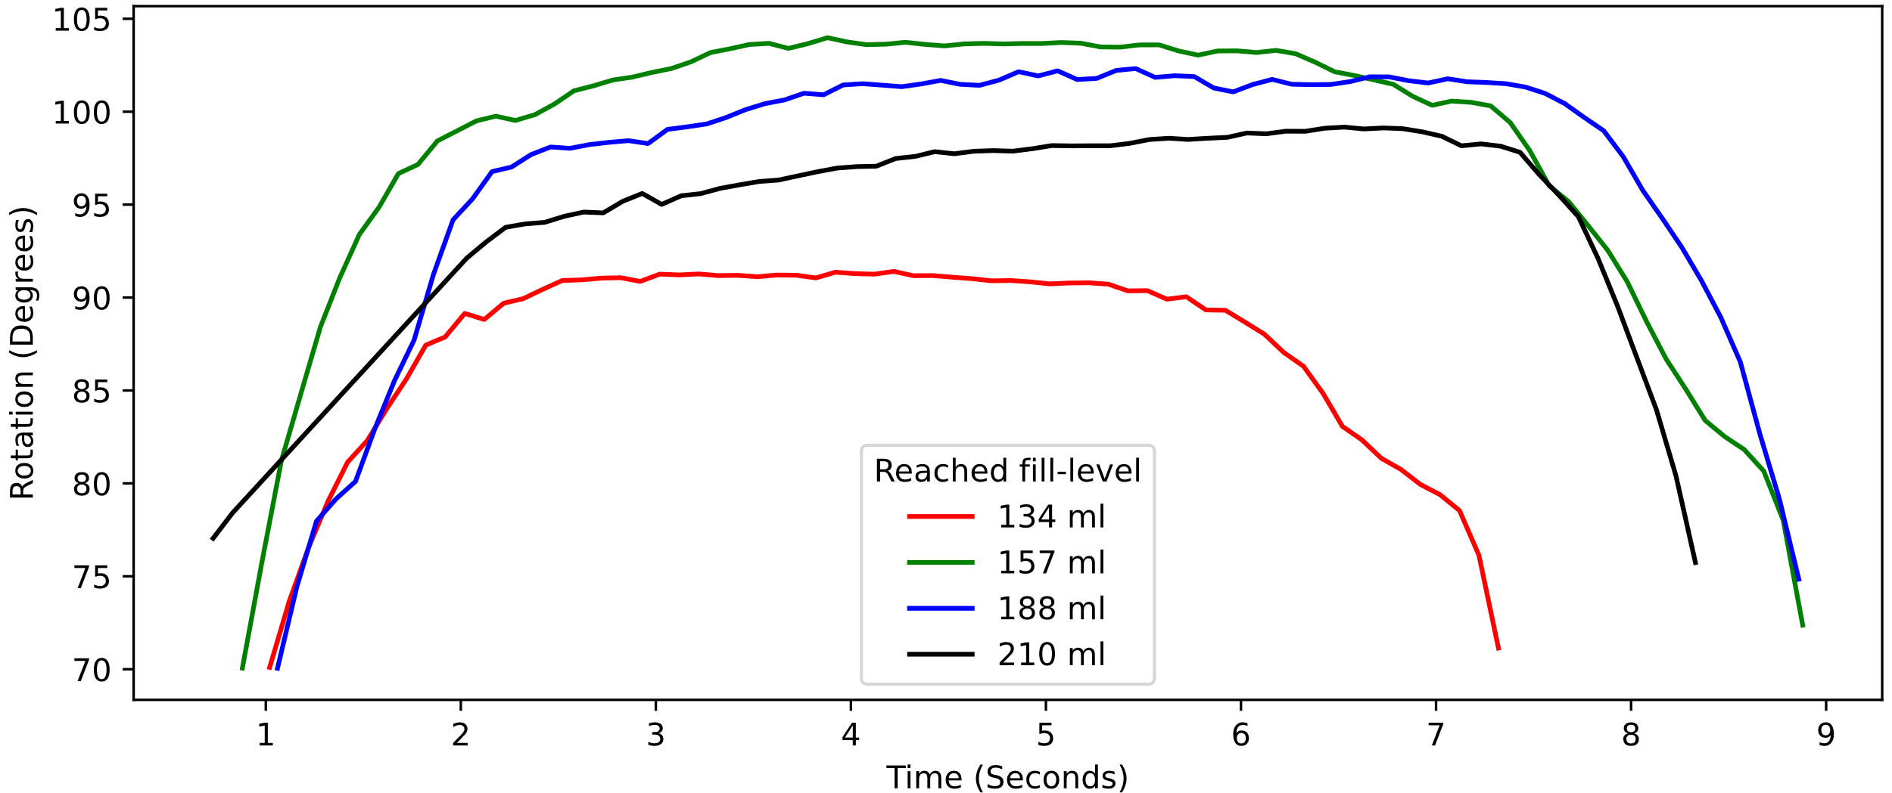
Smoothness of motion
Observation:
Bottle rotation trajectories of the learned policy is too non-smooth to be performed by a human.
RL
Agent
Humans

Slide 15
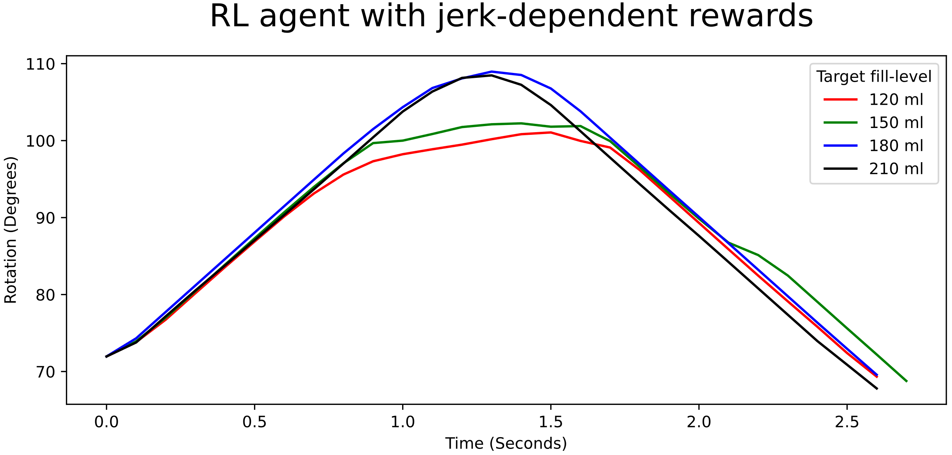
Smoothness of motion
Possible Solution:
Give out some negative reward for high jerk motion of the agent.

Slide 16
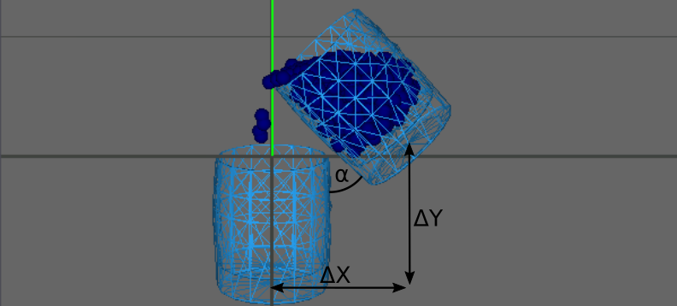
Glass to glass pouring
Can the agent also learn to pour from one glass into another?
What is more difficult, glass to glass or bottle to glass pouring?

Slide 17
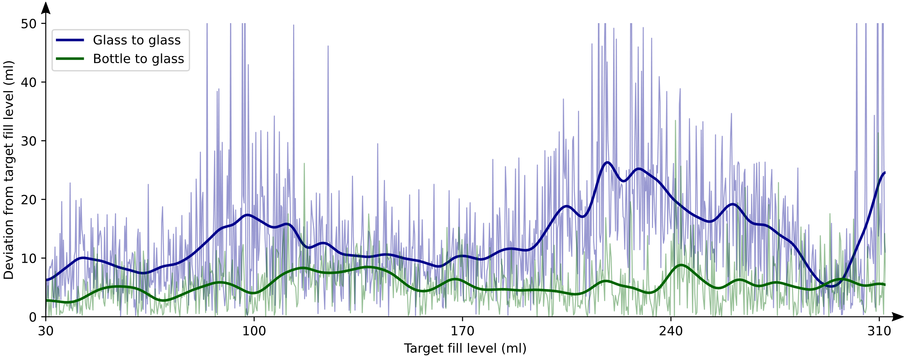
Glass to glass pouring is more difficult

Slide 18
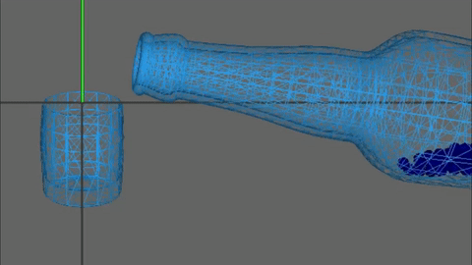
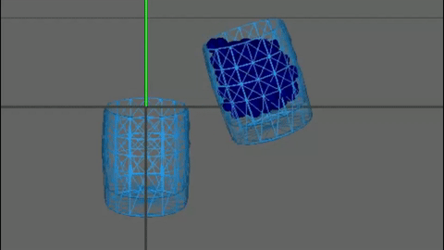
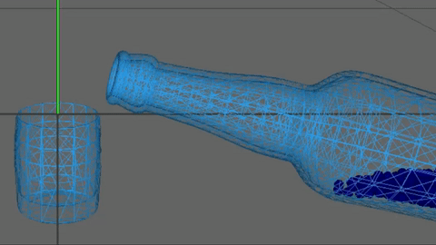
Pouring examples
Smooth pouring
Glass to glass
Low target fill-level

Slide 19
References
FitzGerald, T. H. B., Friston, K. J., & Dolan, R. J. (2012). Action-specific value signals in reward-related regions of the human brain. Journal of Neuroscience,32(46),16417–16423. Retrieved from https://www.jneurosci.org/content/32/46/16417 doi: 10.1523/JNEUROSCI.3254-12.2012
Fujimoto, S., van Hoof, H., & Meger, D. (2018). Addressing function approximation error in actor-critic methods.

Slide 20
Image Sources
https://www.kdnuggets.com/images/reinforcement-learning-fig1-700.jpg
https://raw.githubusercontent.com/InteractiveComputerGraphics/SPlisHSPlasH/master/doc/images/logo.jpg

